Slide 1




Branding Logo
“Business Name”
Used Vehicles
About Us
Contact Us
Shop used cars at “Business Name”
Search our vehicle stock today and purchase how you want! Order Online, by phone or by visiting us in store
Background Image
Featured Items:
Car 1
Car 2
Car 3
Car 4
Car 5

Slide 2




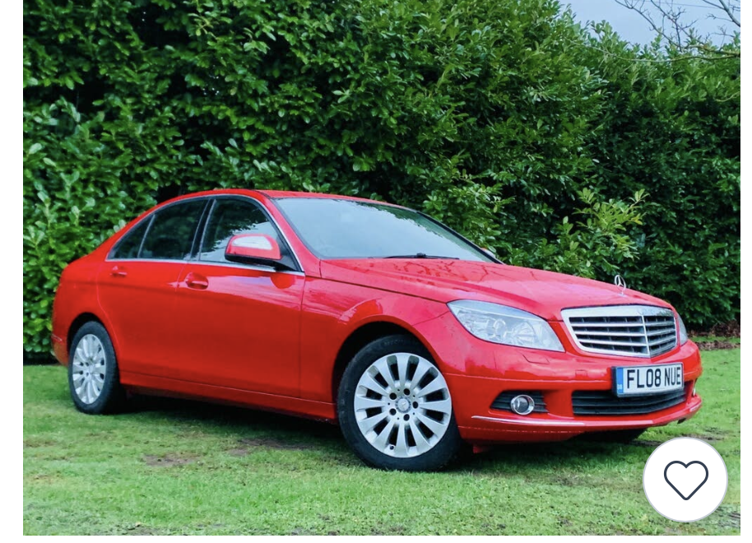
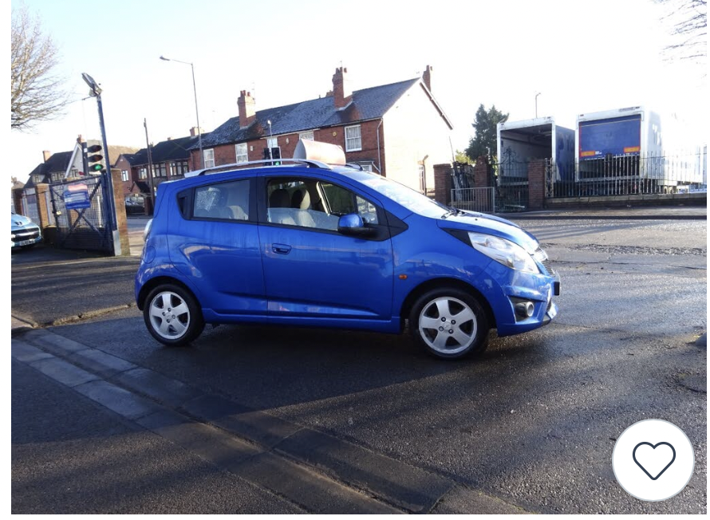
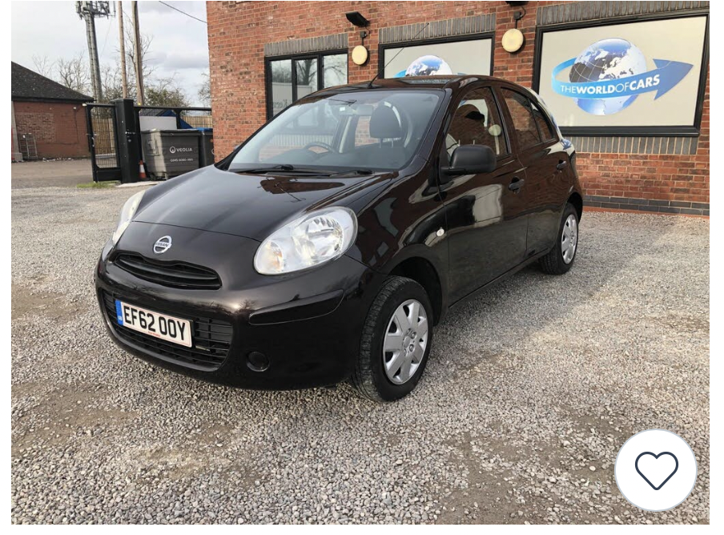
Used Vehicles
Background Image
Makes
All
Models
All
Price
More Options
Car Description
Car Description
Car Description

Slide 3
About Us
Logo
Images
So, who are we?
“Business Name” is a small business that recently opened in 2021. we specialize in the sale of second-hand cars.
Fancy a chat?
If you have a question about a car or simply want to know more about what we do, click the button below!
Get in Touch

Slide 4





Contact Us
Image
Where are we?
With our fast-growing number of employees, we need somewhere to store them all! You can find us at this place below….
Moulsford Miews ,Reading, RG30 1ET
Follow us on our Social Media:
Call Our Office:
0116 546 78464

